Slide 1

Dataglove
Real time object classification by grasping via sensorized glove

Slide 2

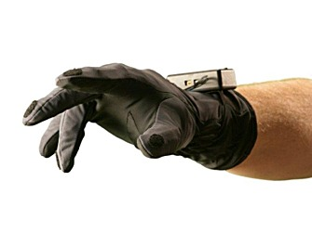
VMG30
Finger flex sensors (10) Measure the bending angle of each phalanx
Abduction sensors (4) Measure the angular distance between adjacent fingers
Pressure Sensors (5) Detect the force applied with the fingertips
Structural Sensors (2) Measure the overall posture of the hand
IMU Units (2) Provide 3D spatial orientation

Slide 3
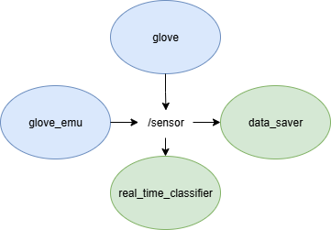
ROS2 architecture
Glove node
Launches two parallel threads:
Thread 1: reads data from the serial port
Thread 2: publishes data on the /sensor topic
Operating frequency: 100 Hz for both threads
Real time classifier node
Subscribes to the /sensor
Maintains a rolling window of 300 time samples
Uses the buffered data to classify the object held by the glove in real time

Slide 4
ROS2 architecture
Data saver node
Subscribes to the /sensor
Store to a file the received data
Used for creating the dataset
Glove emu node
Read data from a file
Publish data to /sensor with a frequency of 100Hz
Used to emulate the glove

Slide 5
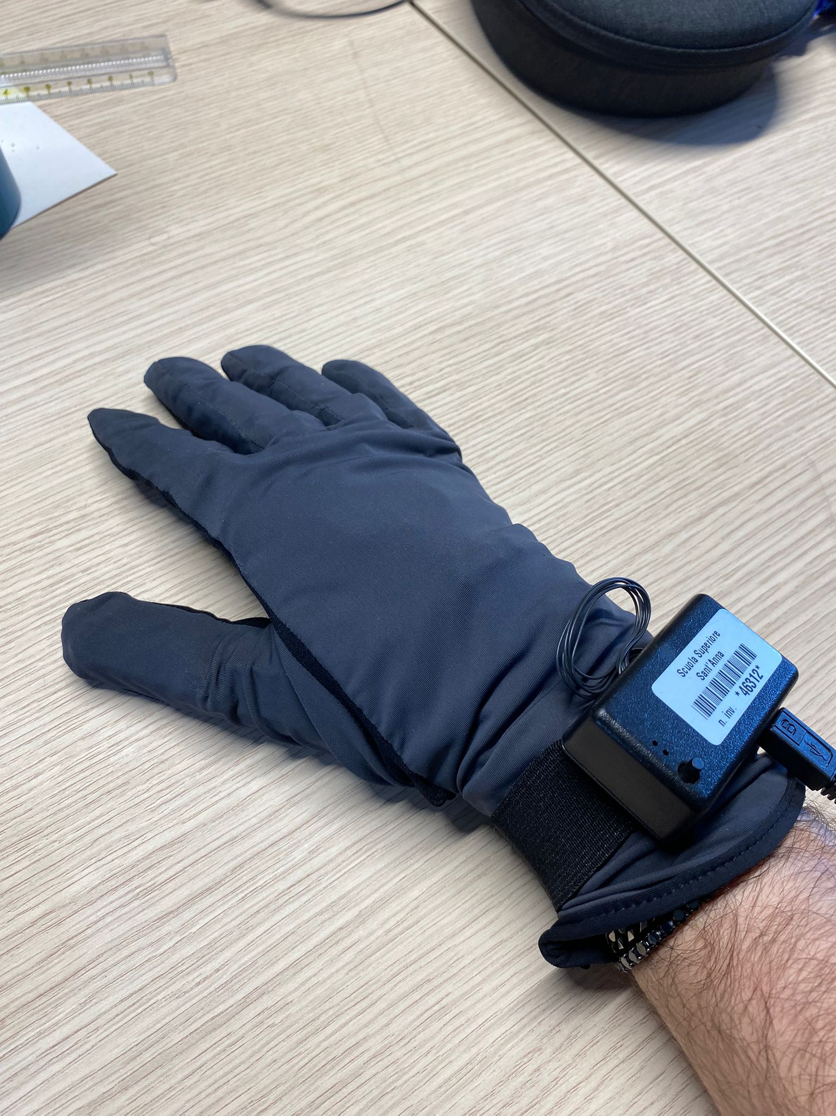
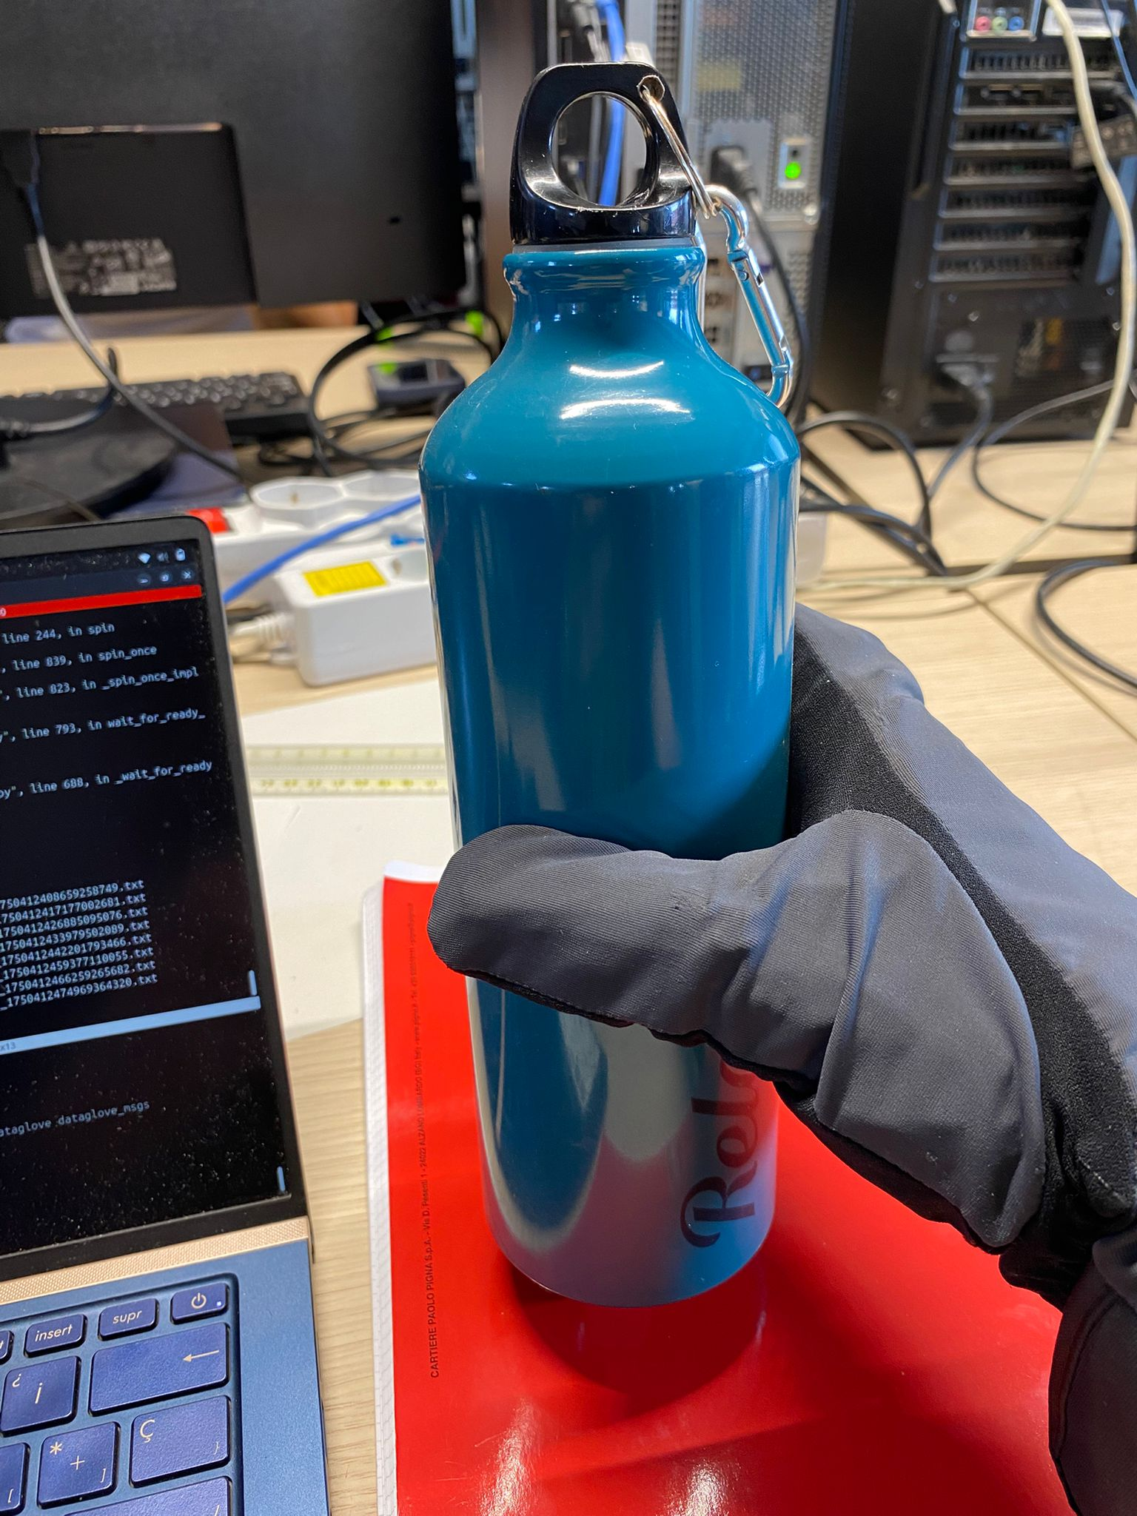
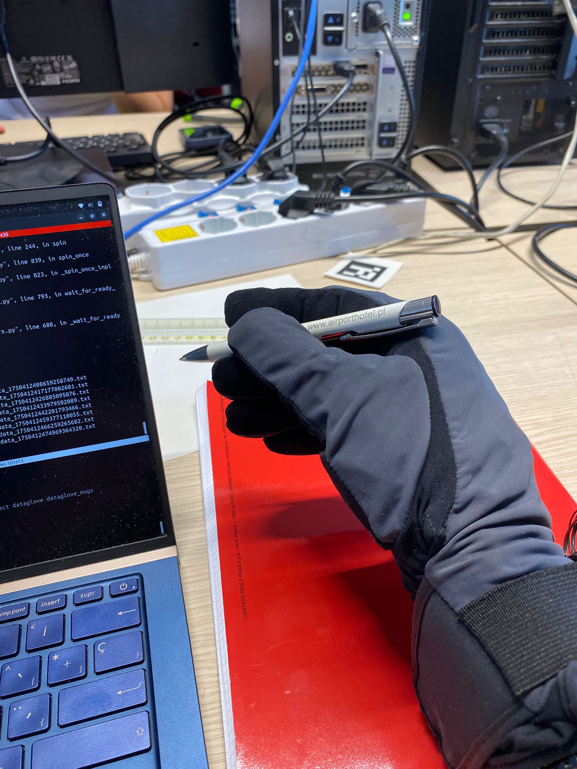
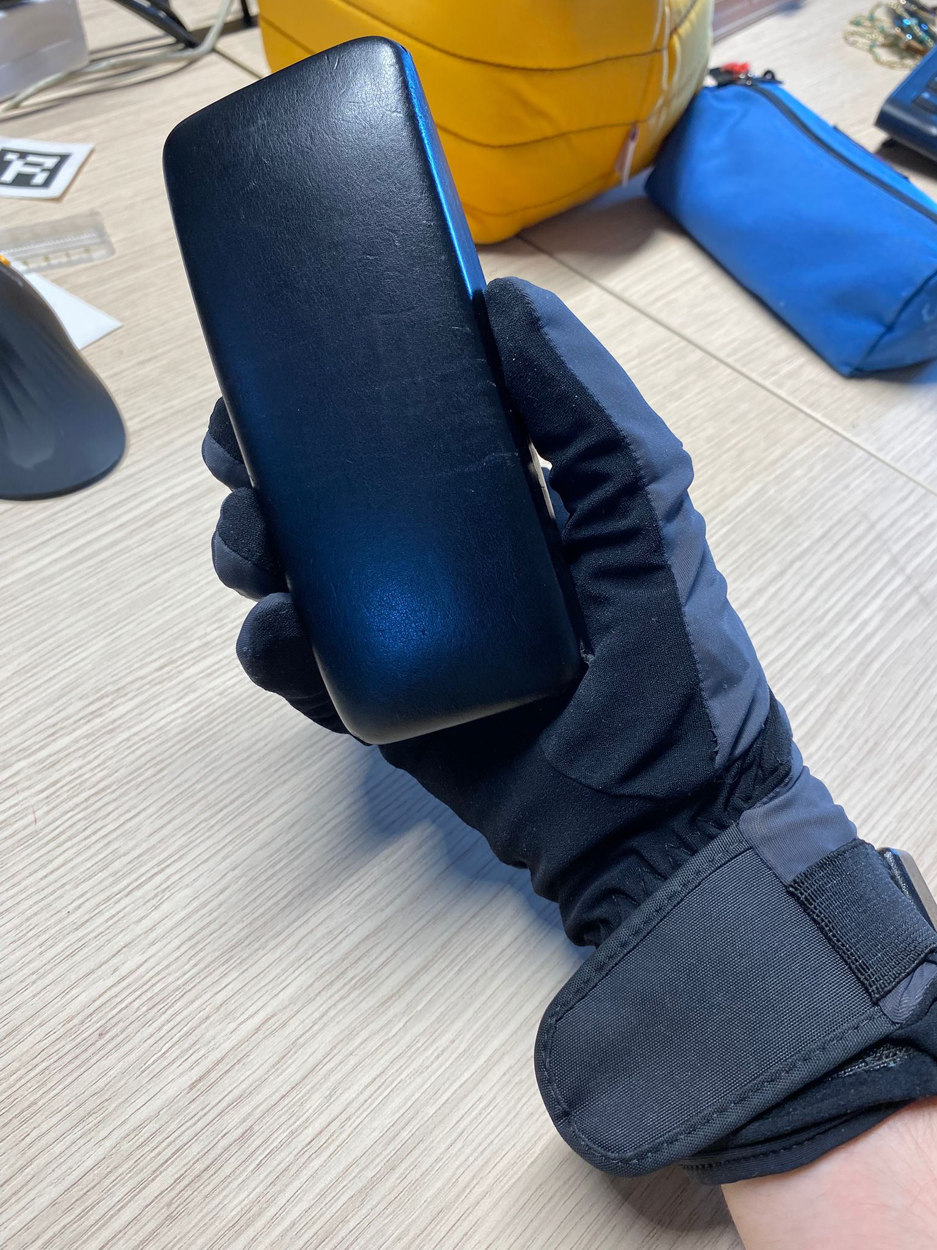
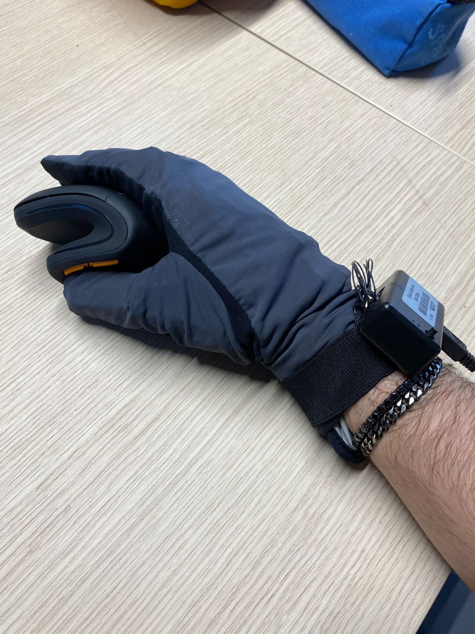
Dataset
6 object
No object (rest position)
Bottle
Pen
Phone
Computer mouse
Glasses case
Execute glove node and data saver node:
~ 1 second in rest position
Move and grasp object
~ 1 second stationary with object in hand

Slide 6
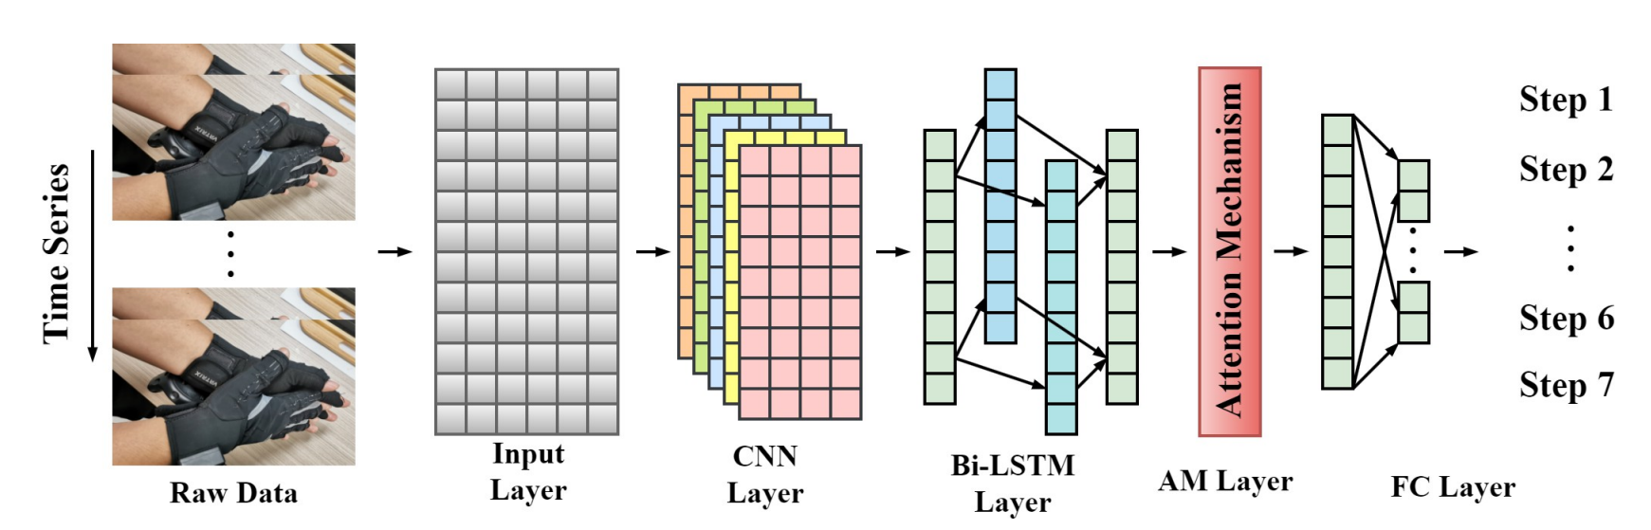
CNN-BiLSTM model with attention mechanism
2 convolutional layer
Kernel size 1x3
2 Bi-LSTM layer
1 Attention Layer
2 Fully connected layer

Slide 7
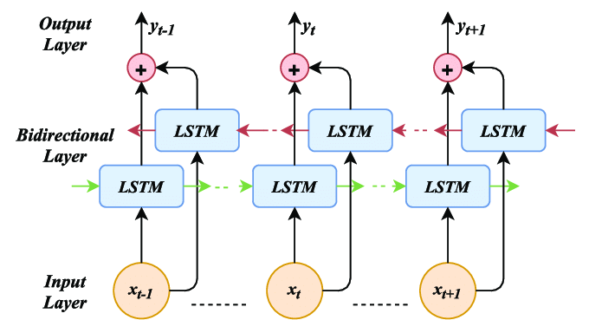
Bidirectional LSTM
LSTM are recurrent NN
They use gating mechanism to mitigate gradient vanishing problem
Bi-LSTM process input sequences in both forward and backward directions
This allows the model to capture context from both past and future states

Slide 8
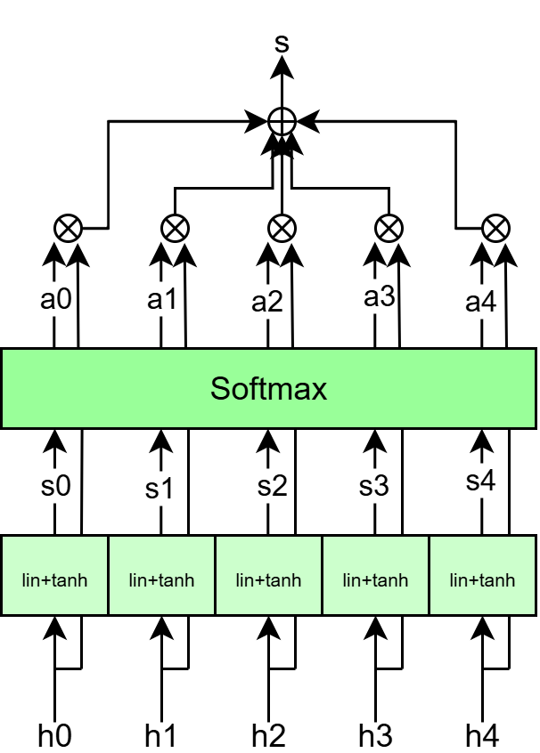

Attention mechanism
Score computation:
$s_{t}=τ\left( w_{h}∗h_{t}+b_{h}\right)$
Attention weights:
$a_{t}= \frac{exp⁡(s_{t})}{\sum{exp⁡(s_{i})}}$
Context vector:
$s=\sum_{t}{a_{t}h_{t}}$
A weighted sum of the scores produces the final context vector, which focuses on the most relevant parts of the input sequence.

Slide 9
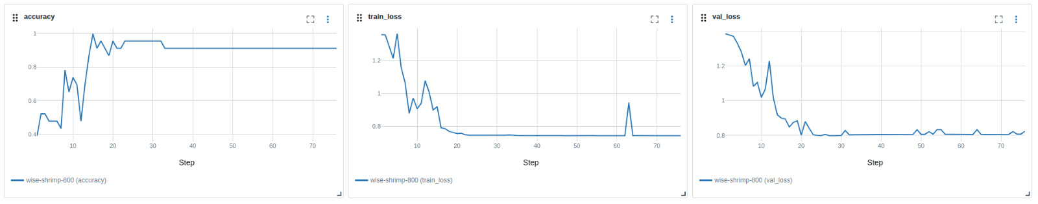
Model training
Dataset split:
60% – Training set
20% – Validation set
20% – Test set
Validation set used for:
Monitoring model performance during training
Implementing early stopping to avoid overfitting
Early stopping strategy:
Training is interrupted if no improvement in validation performance is seen for 50 consecutive epochs

Slide 10
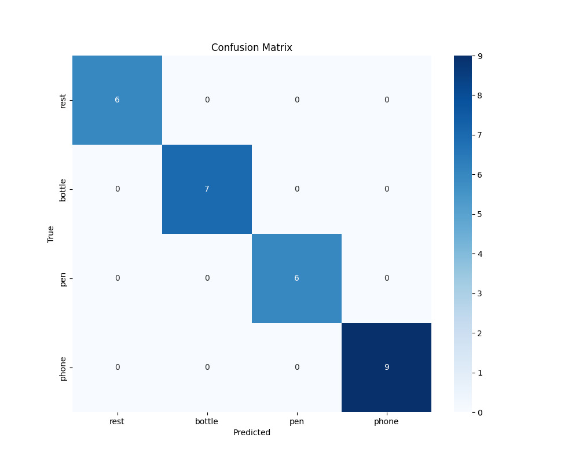
On test set
100% accuracy

Slide 11
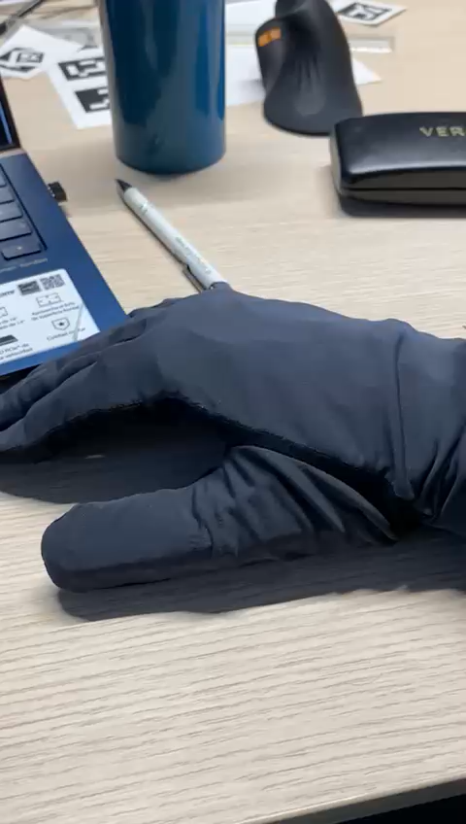
Demo Time

Slide 12
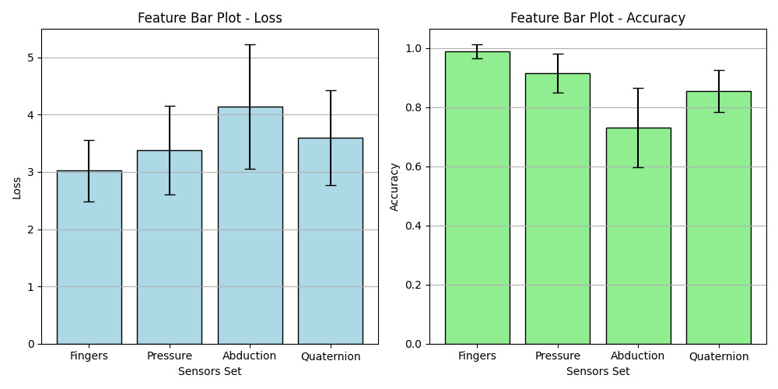
Feature curve and most relevant sensor type
5-fold cross validation
Points are the average value on validation sets
Error bar are standard deviation on validation sets
Finger flex data are the most descriptive

Slide 13
Continual learning
Class incremental learning: I want my classifier to be able to learn new classes (last two object)
Avoid retraining from scratch
Faster
Cheaper
Attention: Catastrophic forgetting

Slide 14
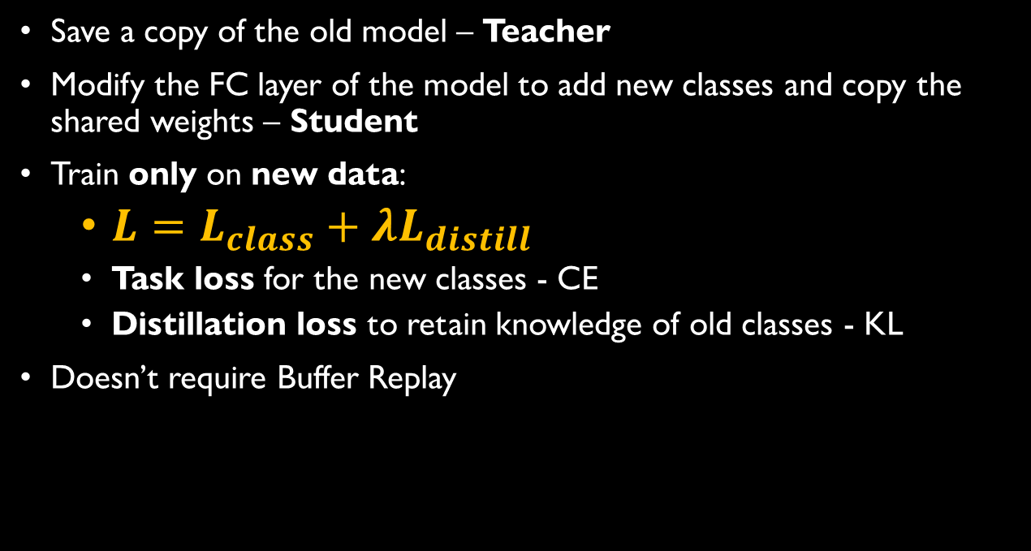
Learning without forgetting
Save a copy of the old model – Teacher
Modify the FC layer of the model to add new classes and copy the shared weights – Student
Train only on new data:
$L=L_{class}+λL_{distill}$
Task loss for the new classes - CE
Distillation loss to retain knowledge of old classes - KL
Doesn’t require Buffer Replay

Slide 15
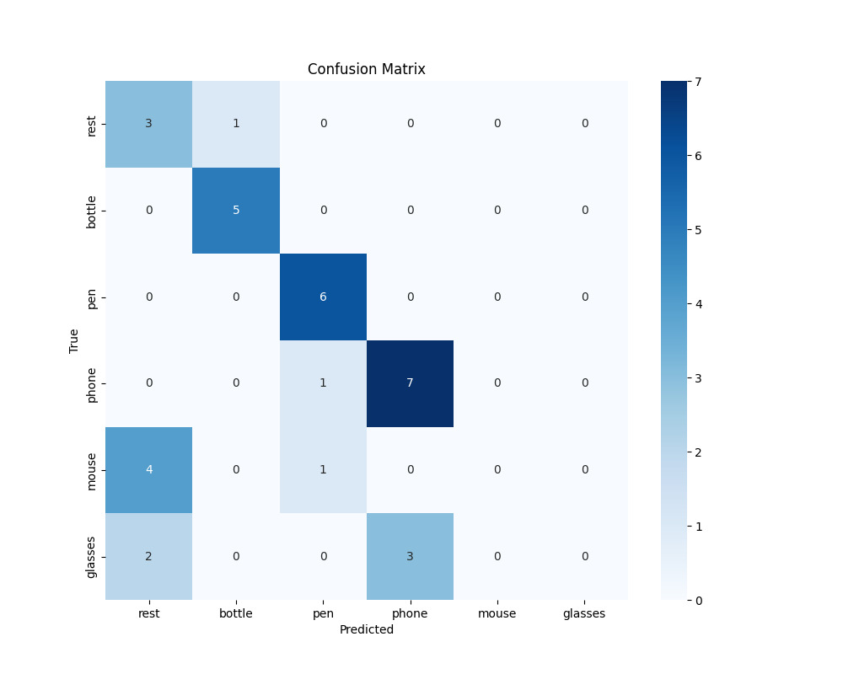
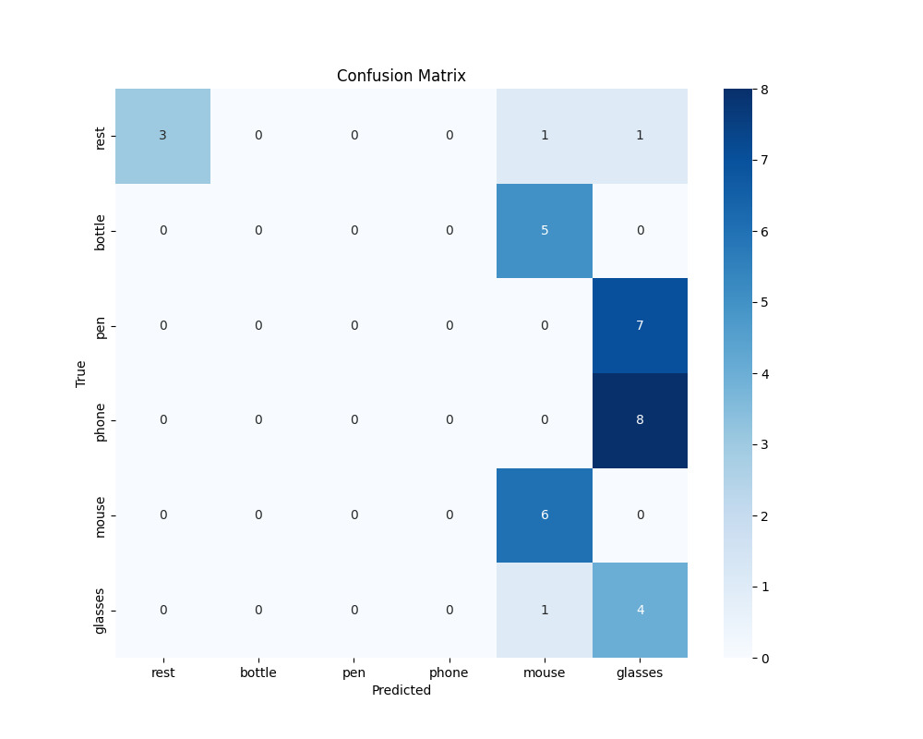
LwF results
If 𝜆 is too large, the model focuses too much on preserving old knowledge
→ It fails to learn the new task properly
If 𝜆 is too small, the model prioritizes learning new data
→ It forgets the previous tasks
→ Catastrophic Forgetting
Choosing the right value of λ is essential to balance stability and plasticity but is hard

Slide 16
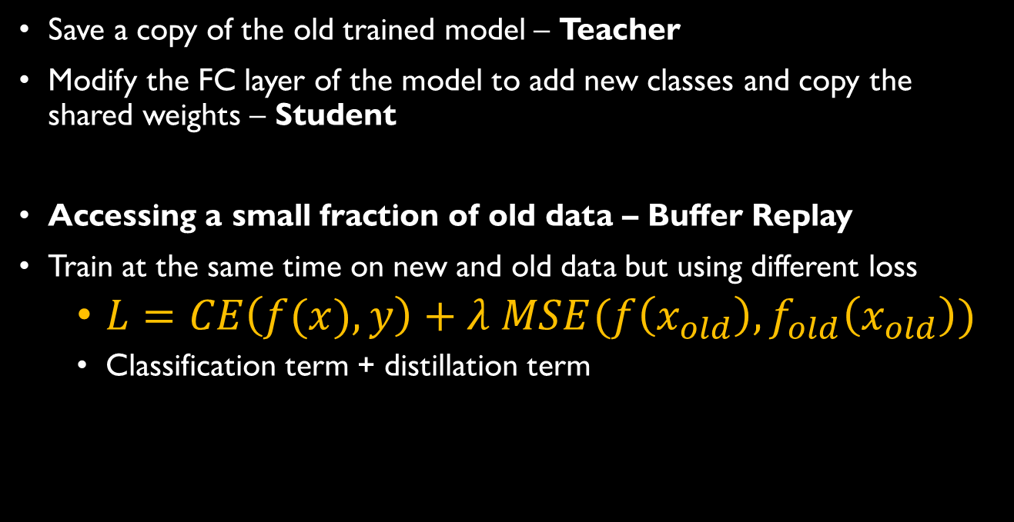
Dark Experience Replay
Save a copy of the old trained model – Teacher
Modify the FC layer of the model to add new classes and copy the shared weights – Student
Accessing a small fraction of old data – Buffer Replay
Train at the same time on new and old data but using different loss
$L=CE\left(f(x),y\right)+λ MSE(f\left(x_{old}\right), f_{old}\left(x_{old}\right))$
Classification term + distillation term

Slide 17
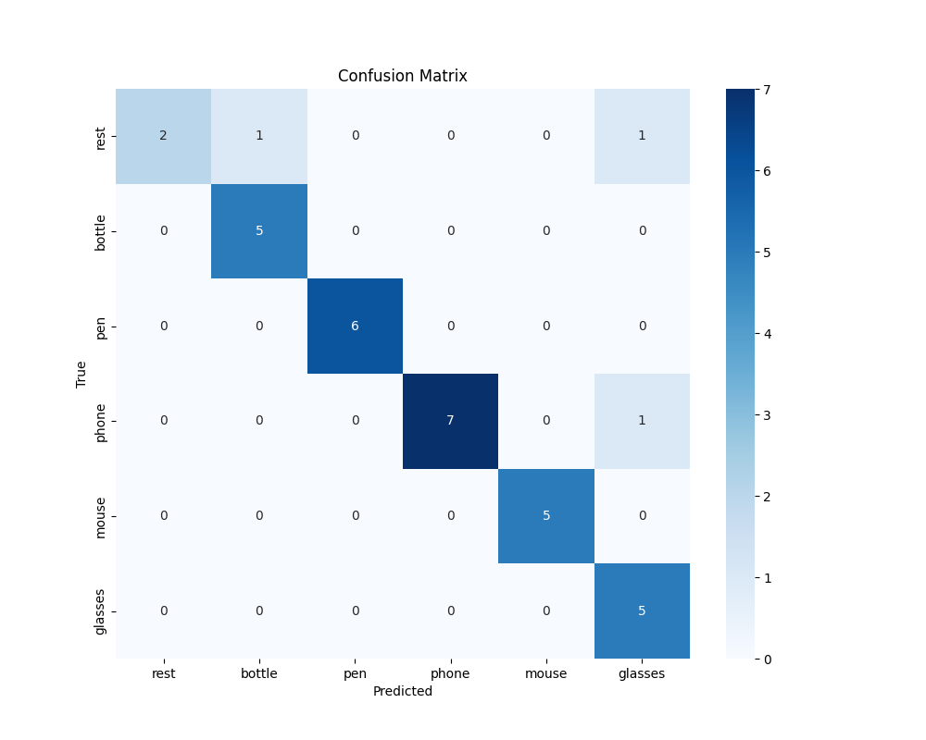

DER results
90% accuracy
New classes are learned successfully
Buffer replay is required but helps mitigate catastrophic forgetting
Easier to choose $λ$

Slide 18
Conclusion
Implemented a state of the art neural network for classifying object via a sensorized glove
Implemented a ros2 program for real time classification
Compared two technique for continual learning:
Learning without forgetting
Dark experience replay

Slide 19
Thanks for you attention. Bibliography:
Data glove-based gesture recognition using CNN-BiLSTM model with attention mechanism, Wu Jiawei et al. (journals.plos)
Learning without Forgetting, Zhizhong Li et al. (arXive)
Dark Experience for General Continual Learning: a Strong, Simple Baseline, Pietro Buzzega et al. (arXive)

Slide 20
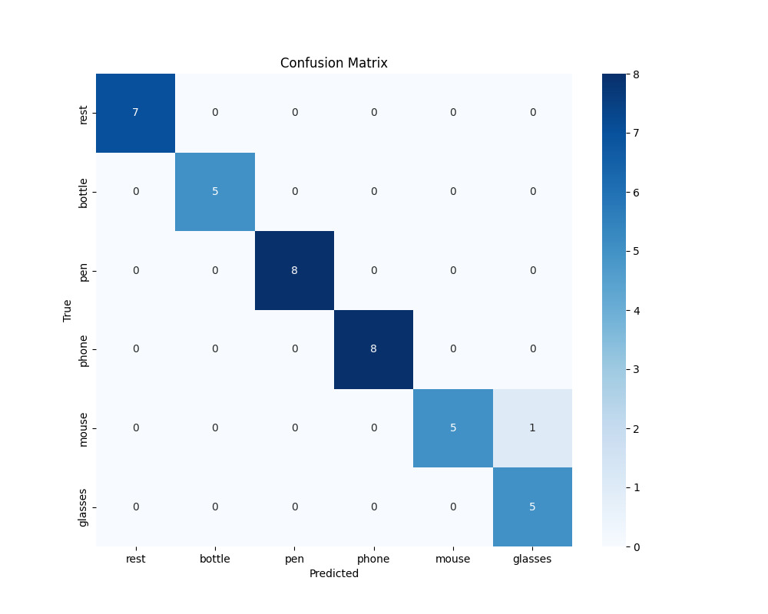
Without continual learning
97% accuracy
Class incremental learning worsen the overall performance of the model

Slide 21
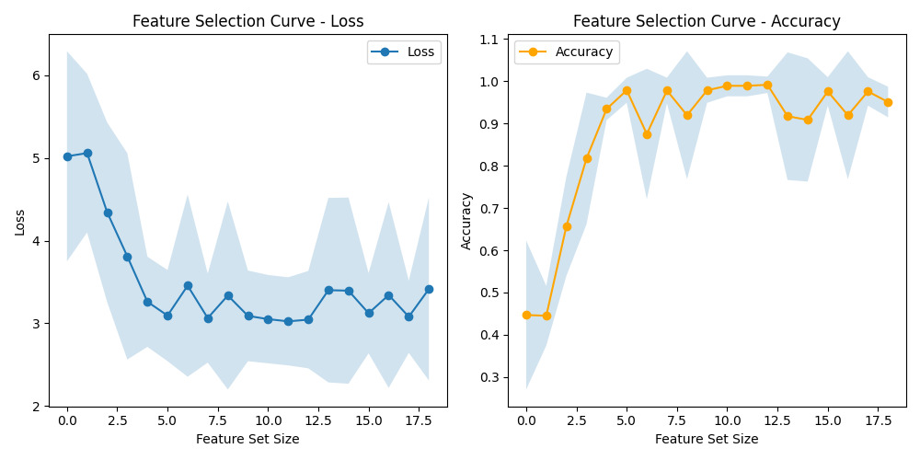
Feature curve and most relevant sensor type
5-fold cross validation
Points are the average value on validation sets
Error bar are standard deviation on validation sets
Finger flex data are the most descriptive

